Slide 1
WIRELESS TEMPERATURE AND HUMIDITY MONITORING SYSTEM USING BLUETOOTH
BY:
Ms. Sneha Ramesh sanap
Under the guidance of:
Ms. Rutuja Karjekar

Slide 2

Table of contents
Introduction
Objective
Requirement
Circuit Diagram
Working
Application
Reference

Slide 3

introduction
Temperature and humidity monitoring system helps you to director problems at an early stage. it controls environment parameters in the of the settings are above or below the allowed range. To address these challenges, the integration of Bluetooth technology into humidity and temperature monitoring systems offers a promising solution. Temperature and humidity control systems by wireless Hc-05 Bluetooth Module.
^{320C}

Slide 4
Objective
To design a temperature and humidity monitor in a personal room , storage room or a transport vehicle.
It will be controlled by a computerized program using a C or C++ code.
Transmitted data will be used to determine the temperature and humidity.
It will also be able send a wireless signal to a receiver device a pc a tablet or even a smartphone.
Provide an easy-to-use interface for users to view and anlyze the data, possible through a mobile app or software.

Slide 5
Requirement
Hardware requirement
Solder Breadboard
Arduino UNO
16x2 LCD Display
Hc-05 Bluetooth Module
100R Resistor
4.7k Resistor
1k Resistor
Male to male jumper wires
Battery 9v
DHT-11 Temperature & Humidity sensor
Software requirement
Arduino IDE
Proteus 8 Professional
Programming language C/C++
Online mit app inventor

Slide 6
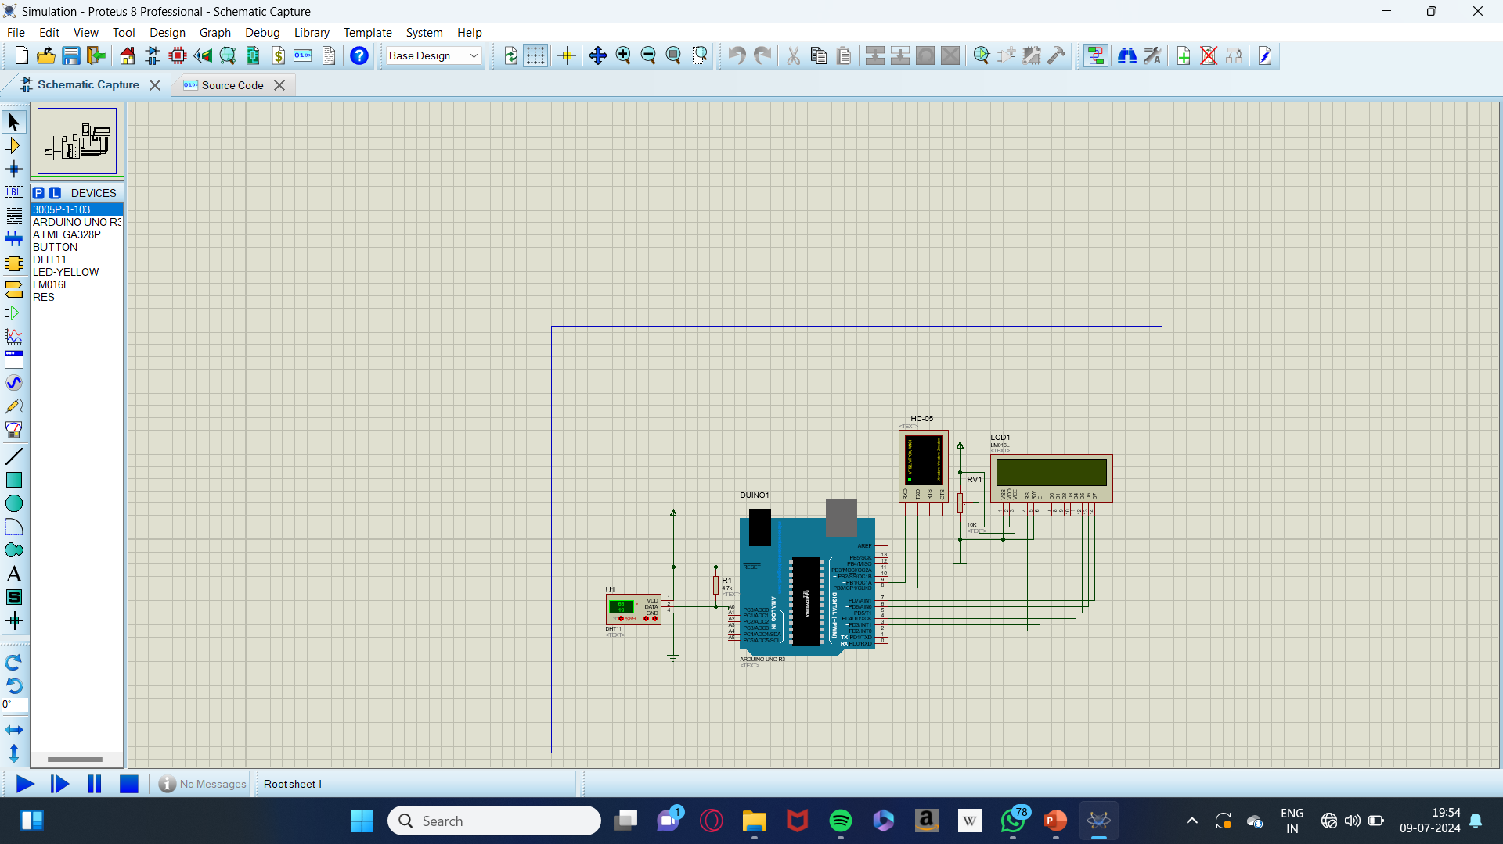
CIRCUIT DIAGRAM

Slide 7
Working
Working of this project is based on single wire serial communication. First Arduino send a start to DHT module and then DHT gives a response signal to containing temperature and humidity data. Arduino collect and extract in two parts one is humidity and second is temperature and then send them to 16x2 LCD.
Here is this project we have used a sensor module namely DHT11. This module features A humidity and temperature complex with a calibrated digital signal output means DHT11 sensor module is a combined module for sensing humidity and temperature which gives a calibrated digital output signal. DHT11 gives us very precise value of humidity and temperature and ensure high reliability and long team stability.

Slide 8
application
HVAC system monitoring
Environmental monitoring
Controlled ambient monitoring(for examples , server rooms)
Medical patient support
Hydroponics
Milk dairies
Restaurants

Slide 9
Thank you

